Slide 1
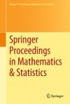











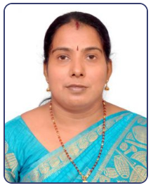


ICMLBDA 2023
3nd International Conference on
Machine Learning and Big Data Analytics
29-30th May 2023
Paper ID - 158
Human stress detection in sleep mode compared with non-sleep mode using machine learning algorithms
Presented By:
Dr.Sajidha S A, Sanjay M, Pillaram Manoj,DR.Sheik Abdullah A, Dr.Priyadarshini R, Dr.Nisha V M ,Dr.Aakif Mairaj
Vellore Institute of Technology, Chennai, Tamil Nadu, India.

Slide 2

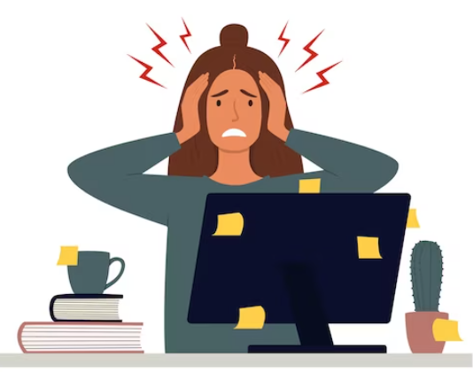
ICMLBDA 2023
Title:Human stress detection in sleep mode compared with non-sleep mode using machine learning algorithms
INTRODUCTION:
Stress is a difficult and severe psychological condition that occurs when the body experiences stress against any kind of pressure.
This need may come from a wide range of sources, including employment, family and personal connections.
Chronic and long-term stress can have harmful impacts on physical and mental health, such as headaches, sleep difficulties and an increased risk of cardiovascular disease.
To avoid long-term harmful consequences, it is important to recognize and control stress.
These applications couldn't provide more effective and affordable mediations in challenging work environments, much alone more beneficial circumstances where workers would be more willing to handle their responsibilities.
In addition to causing mental health problems, human pressure also leads to socioeconomic problems, a lack of trust in the workplace, strained professional relationships, melancholy, and in some extreme situations, the long-term compulsion to commit suicide.
They could end up in a very long period of constant anxiety and terror as a result.
Over time, it may negatively impact both physical and mental health.
People are hence uneasy despite their thriving. The strain may be profound, physical, or even mental in origin.
Paper ID-158 ICMLBDA 2023

Slide 3
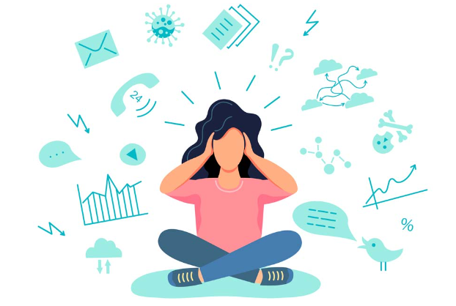
ICMLBDA 2023
Title: Human stress detection in sleep mode compared with non-sleep mode using machine learning algorithms
OBJECTIVE
Stress
people from many areas of life are affected by stress.
It occurs often across all occupations and age groups.
Factors for Causing Stress:
High workload and tight deadlines
Conflict with colleagues or superiors
Fear of job loss or unemployment
Lack of control or autonomy in the workplace.
Long working hours and overtime demands.
We propose to use sleep data set in order to predict the stress levels as compared to non-sleep mode data which has attributes like Snoring range, Respiration rate, Body temperature, Limb movement rate, Blood oxygen levels, Eye movement, Number of hours slept, Heart rate with Stress levels classified from 0 (low/normal) to 4 (extreme) (high).
We compare the performance of Logistic regression, XGB classifier, Randomforest classifier, Navie bayes, Decision tree, LightGBM, CatBoost(Categorical Boosting), GradientBoosting Regressor, SVM,ANN and KNN models to predict the stress levels for sleep mode data.
We found that only SVM and Naïve bayes gave a maximum accuracy of 85% stress prediction accuracy using non – sleep mode data whereas many models like Logistic regression, Navie bayes, LightGBM, CatBoost, SVM, KNN predicted with 100% accuracy for sleep mode data.
Paper ID-158 ICMLBDA 2023

Slide 4
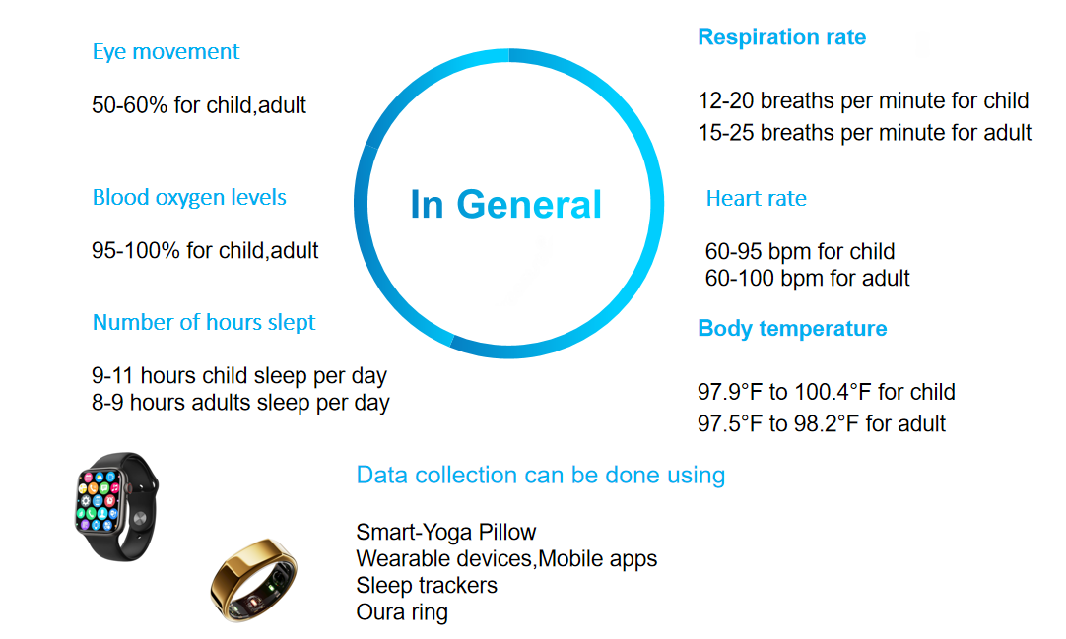

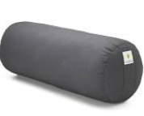
ICMLBDA 2023
Title: Human stress detection in sleep mode compared with non-sleep mode using machine learning algorithms
Paper ID-158 ICMLBDA 2023

Slide 5
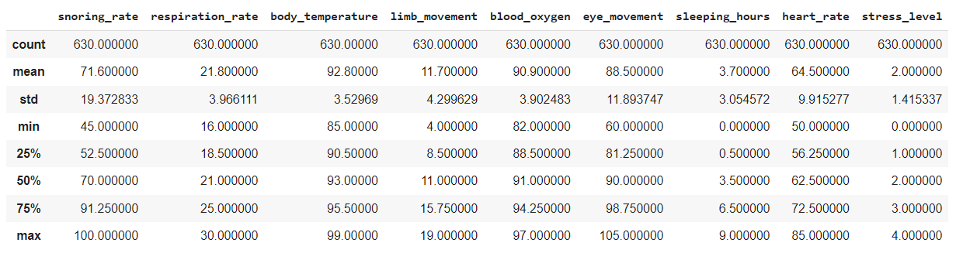
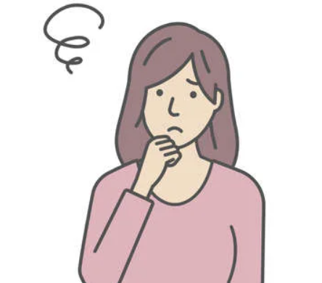

ICMLBDA 2023
Title: Human stress detection in sleep mode compared with non-sleep mode using machine learning algorithms
Description of Sleeping_Dataset
Many people nowadays sleep without considering the benefits, sleep brings to the human body. The Smart-Yoga Pillow (SaYoPillow) is presented as an edge device to aid in the understanding of the link between stress and sleep.
Stress Levels
(0- low/normal, 1 – medium low, 2- medium, 3-medium high, 4 -high)
Paper ID-158 ICMLBDA 2023

Slide 6
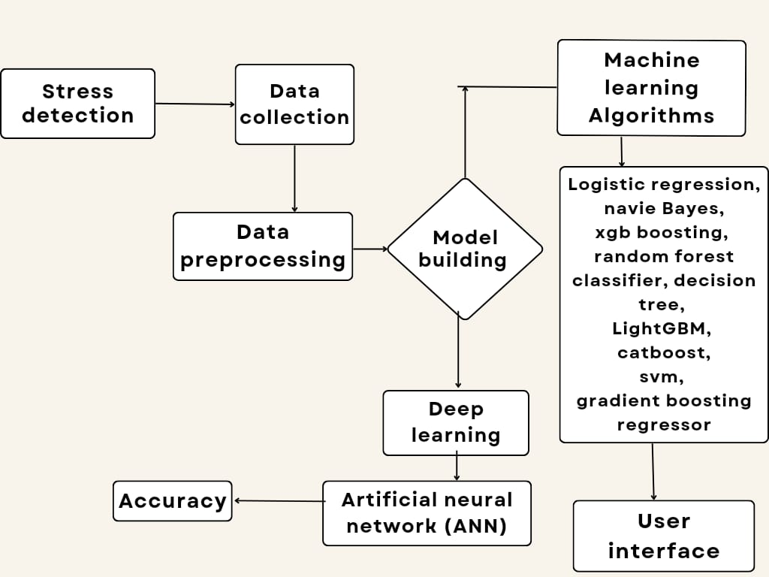


ICMLBDA 2023
Title: Human stress detection in sleep mode compared with non-sleep mode using machine learning algorithms
Proposed Architecture:
Paper ID-158 ICMLBDA 2023

Slide 7
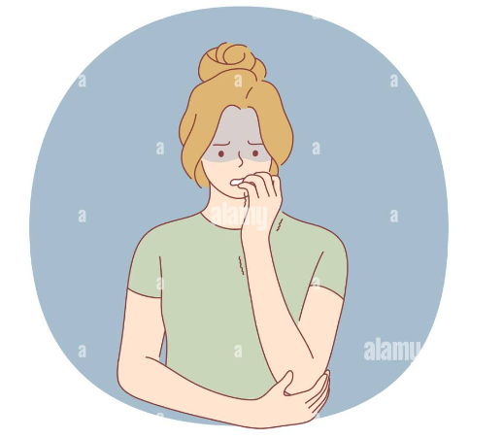
ICMLBDA 2023
Title: Human stress detection in sleep mode compared with non-sleep mode using machine learning algorithms
Machine learning
Logistic regression :- The goal of logistic regression is to forecast stress levels using physiological cues including heart rate, respiration rate, blood oxygen level, body temperature and eye movements
XGB,Random forest classifier :-The XGB,Random forest classifier is a binary classification implementation of the XGBoost,Random forest algorithm. To reduce overfitting and increase generalization performance, it employs an ensemble of decision trees and regularization algorithms.
Naive Bayes :- The Naive Bayes classifier predicts the chance of an individual being in the high-stress group based on a dataset that contains physiological signal data and stress level evaluations.
SVM :- The Support Vector Machine (SVM) is a well-known machine learning technique for classification and regression analysis. SVM has several uses in a variety of industries, including banking, bioinformatics, image classification, and text classification.
Paper ID-158 ICMLBDA 2023

Slide 8
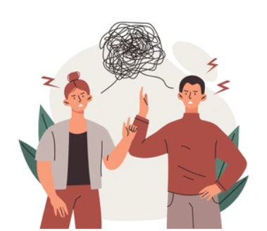
ICMLBDA 2023
Title: Human stress detection in sleep mode compared with non-sleep mode using machine learning algorithms
Decision Tree :- Decision Tree algorithm is a machine learning strategy for categorization analysis.The algorithm is used to predict whether or not a person would fall into the high-stress group.
KNN :- The k-nearest neighbours’ algorithm is a non-parametric, supervised learning classifier that uses distance to create classifications or predictions about an individual data point's grouping.
LightGBM :- LightGBM is a framework for gradient boosting that use tree-based learning techniques.Gradient-based One-Side Sampling (GOSS), a cutting-edge method used by LightGBM
CatBoost :- Categorical Boosting is a machine learning technique that is specifically developed to operate with categorical information and solve some of the limitations of classic gradient boosting methods.
Gradient Boosting Regressor :- The Gradient Boosting Regressor (GBR), a machine learning technique, is a member of the ensemble boosting method family. In an iterative process, it turns a number of poor learners into a single strong learner.
Paper ID-158 ICMLBDA 2023

Slide 9


ICMLBDA 2023
Title: Human stress detection in sleep mode compared with non-sleep mode using machine learning algorithms
Our models with accuracy -[sleeping data]
S.no | Algorithms | Accuracy
1. | Logistic regression | 100%
2. | XGB classifier | 98%
3. | Random forest classifier, | 98%
4. | Navie bayes | 100%
5. | Decision tree | 98.4%
6. | LightGBM | 100%
7. | CAT Boost(Categorical Boosting) | 100%
8. | Gradient Boosting Regressor | 99.65%
9. | SVM | 100%
10. | ANN | 73%
11. | KNN | 100%
Paper ID-158 ICMLBDA 2023

Slide 10


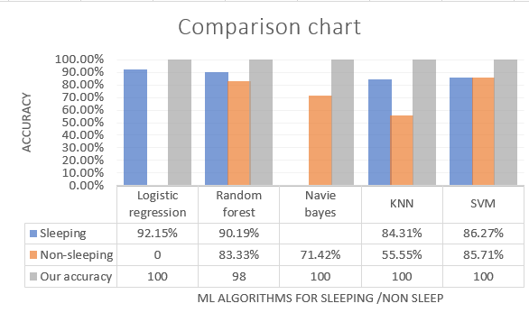
ICMLBDA 2023
Title: Human stress detection in sleep mode compared with non-sleep mode using machine learning algorithms
Comparison of Accuracy with research papers
Algorithms | Logistic regression | Random forest | Navie bayes | KNN | SVM
Sleeping | 92.15% | 90.19% |  | 84.31% | 86.27%
Non-sleeping | - | 83.33% | 71.42% | 55.55% | 85.71%
Our accuracy | 100 | 98 | 100 | 100 | 100
It shows the performance of our dataset namely “Sleeping” on different machine learning algorithms with the algorithms in literature survey. Logistic regression, Navie bayes , LightGBM, CatBoost(Categorical Boosting),SVM and KNN has the highest accuracy’s of 100%, indicating that it may be the most suitable algorithm for the dataset.
Paper ID-158 ICMLBDA 2023

Slide 11

ICMLBDA 2023
Title: Human stress detection in sleep mode compared with non-sleep mode using machine learning algorithms
why we got 100% accuracy’s compared to research papers:
Compare to other research papers, our dataset consists of high quality of data and we have more informative features and we have selected appropriate machine learning algorithms
High-quality dataset: we had a well-organized dataset with accurate and informative attributes.
Appropriate algorithm selection: We used a variety of methods, including logistic regression, random forest, Naive Bayes, K-nearest neighbours (KNN), and support vector machines (SVM). Each approach has strengths and weaknesses, and by combining them, we were able to cover a wide range of features in the dataset.
Informative features: The features in your dataset, such as snoring range, respiration rate, body temperature, limb movement rate, blood oxygen levels, eye movement, number of hours slept, heart rate, and stress levels, can have major relations with the target variable (sleeping).
Paper ID-158 ICMLBDA 2023

Slide 12

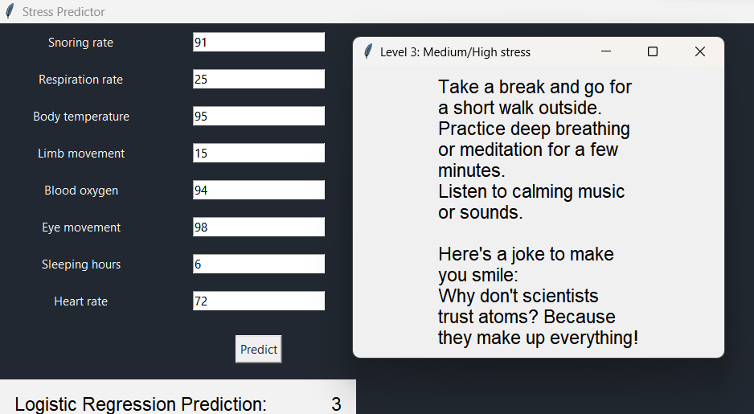

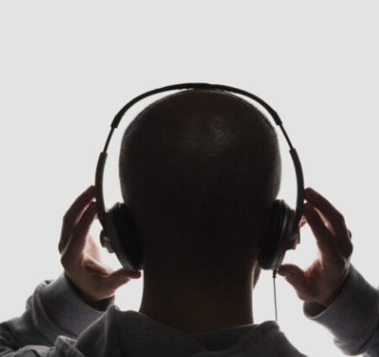
ICMLBDA 2023
Title: Human stress detection in sleep mode compared with non-sleep mode using machine learning algorithms
User Interface :
User interface for predicting stress levels using Logistic Regression algorithm by the help of features like Snoring rate, Respiration rate and other features and it Shows the interface developed which will predict the level of stress and recommend action that can be taken to reduce it.
Paper ID-158 ICMLBDA 2023

Slide 13

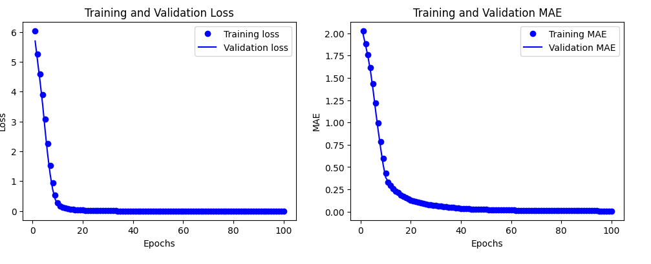
ICMLBDA 2023
Title: Human stress detection in sleep mode compared with non-sleep mode using machine learning algorithms
Deep Learning:
Artificial Neural Network(ANN) are a subset of machine learning models that take their cues from the design and operation of biological neural networks seen in the human brain.
An input layer, one or more hidden layers, and an output layer are the three layers that make up an artificial neural network (ANN).
It have been used successfully in a variety of applications, including picture and audio recognition, natural language processing, and predictive modelling in fields such as finance, healthcare and marketing.
The epoch is 100 for ANN and the above plot is for training, validation loss and training, validation MAE for ANN algorithm. The accuracy for ANN algorithm is 73%.
Paper ID-158 ICMLBDA 2023

Slide 14

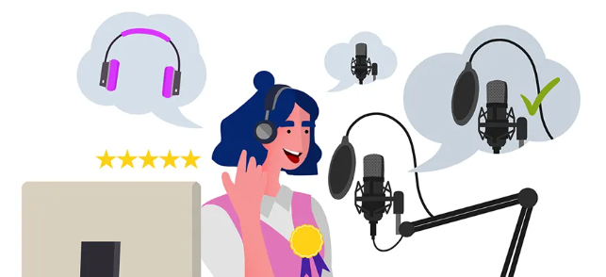
ICMLBDA 2023
Title: Human stress detection in sleep mode compared with non-sleep mode using machine learning algorithms
CONCLUSION:
The study used several methods to predict human stress, including logistic regression, XGB classifier, random forest classifier, Navie Bayes, decision tree, LightGBM, CatBoost, Gradient Boosting Regressor, KNN, SVM and ANN.
When the accuracy of each algorithm was measured, machine learning algorithms such as SVM, logistic regression, Catboost, LightGBM, KNN and Navie Bayes were found to have the best accuracy (100%) when compared to deep learning algorithm ANN.
We are getting the inputs from the user(manually) or using any instruments to measure and based on the inputs we are predicting stress level of the person and each level will increase by 25% and there will be 4 levels.
Our research shows that machine learning systems can effectively anticipate stress levels.Our study also found that parameters like limb movement, snorting rate, respiratory rate, body temperature, spo2 level, eye movement, sleeping hours, heart rate could accurately predict human stress levels. According to the findings, machine learning algorithms using Sleep mode can be used to predict stress levels.
Paper ID-158 ICMLBDA 2023

Slide 15
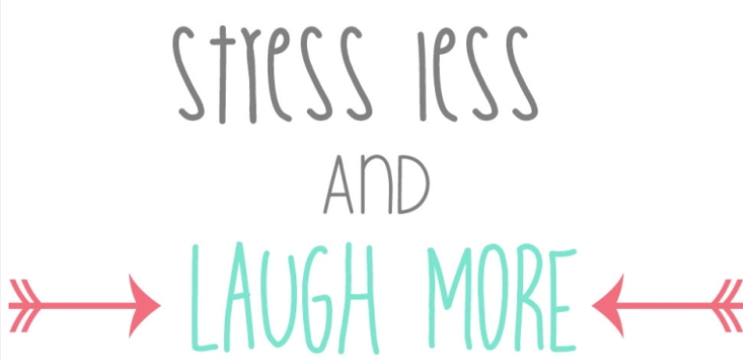
ICMLBDA 2023
Title: Human stress detection in sleep mode compared with non-sleep mode using machine learning algorithms
Thank You
sajidha.sa@vit.ac.in
sanjay.m2020a@vitstudent.ac.in
pillaram.manoj2020@vitstudent.ac.in
sheikabdullah.a @vit.ac.in
priyadarshini.r@vit.ac.in
nishavm@vit.ac.in
amairaj@iu.edu - Computer Science and Informatics, Indiana University, Kokomo.
Paper ID-158 ICMLBDA 2023

